Slide 1

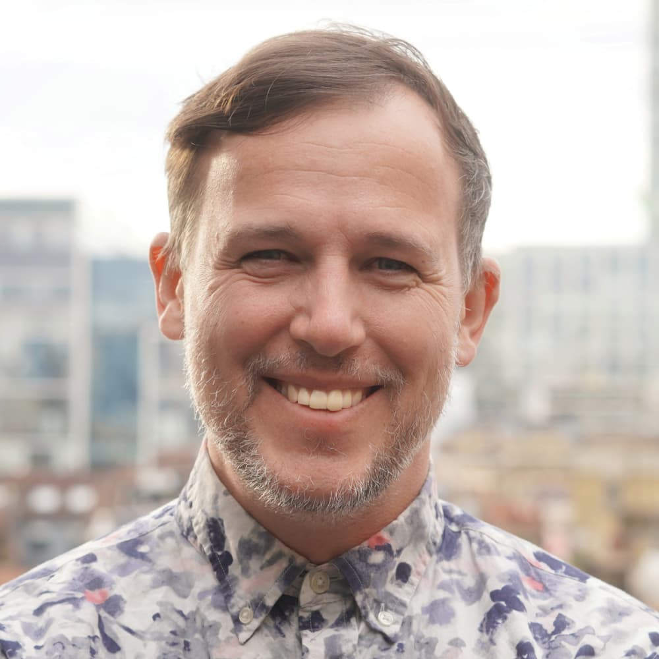
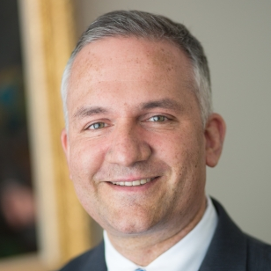
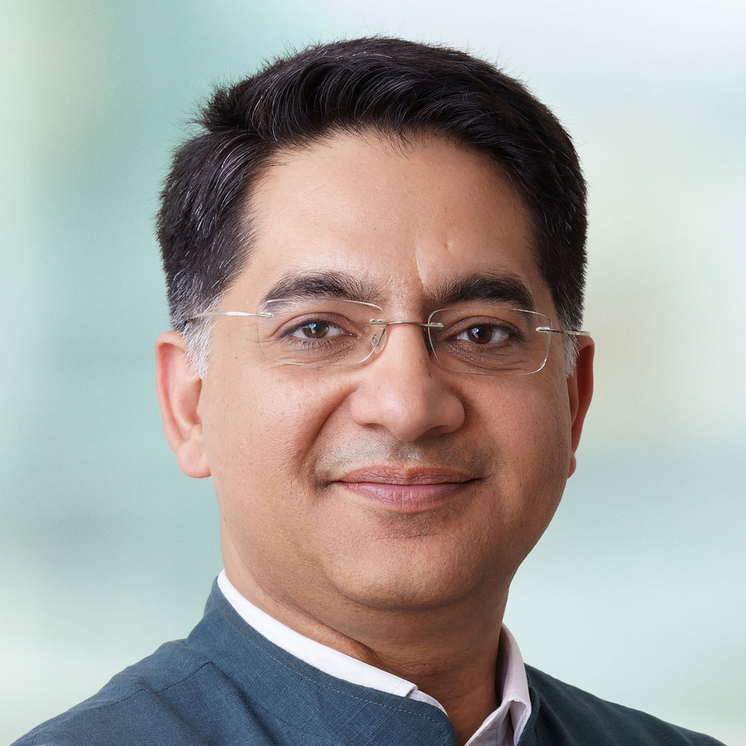
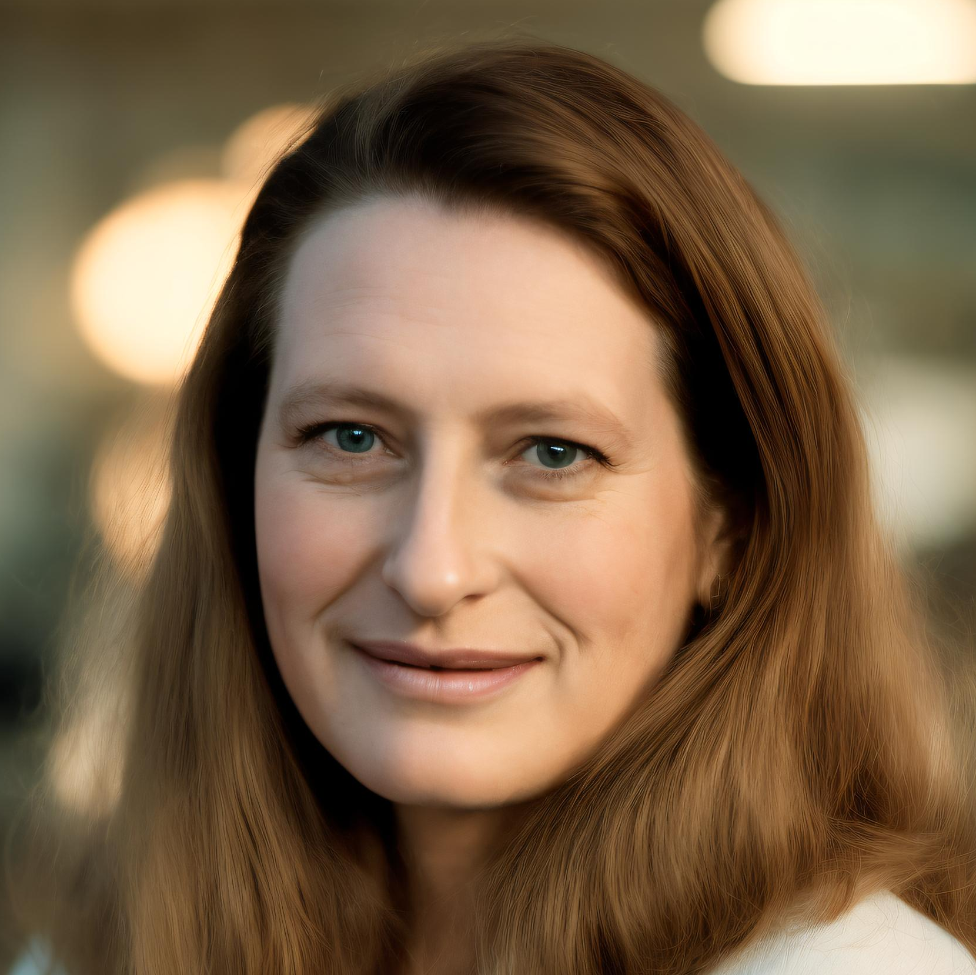
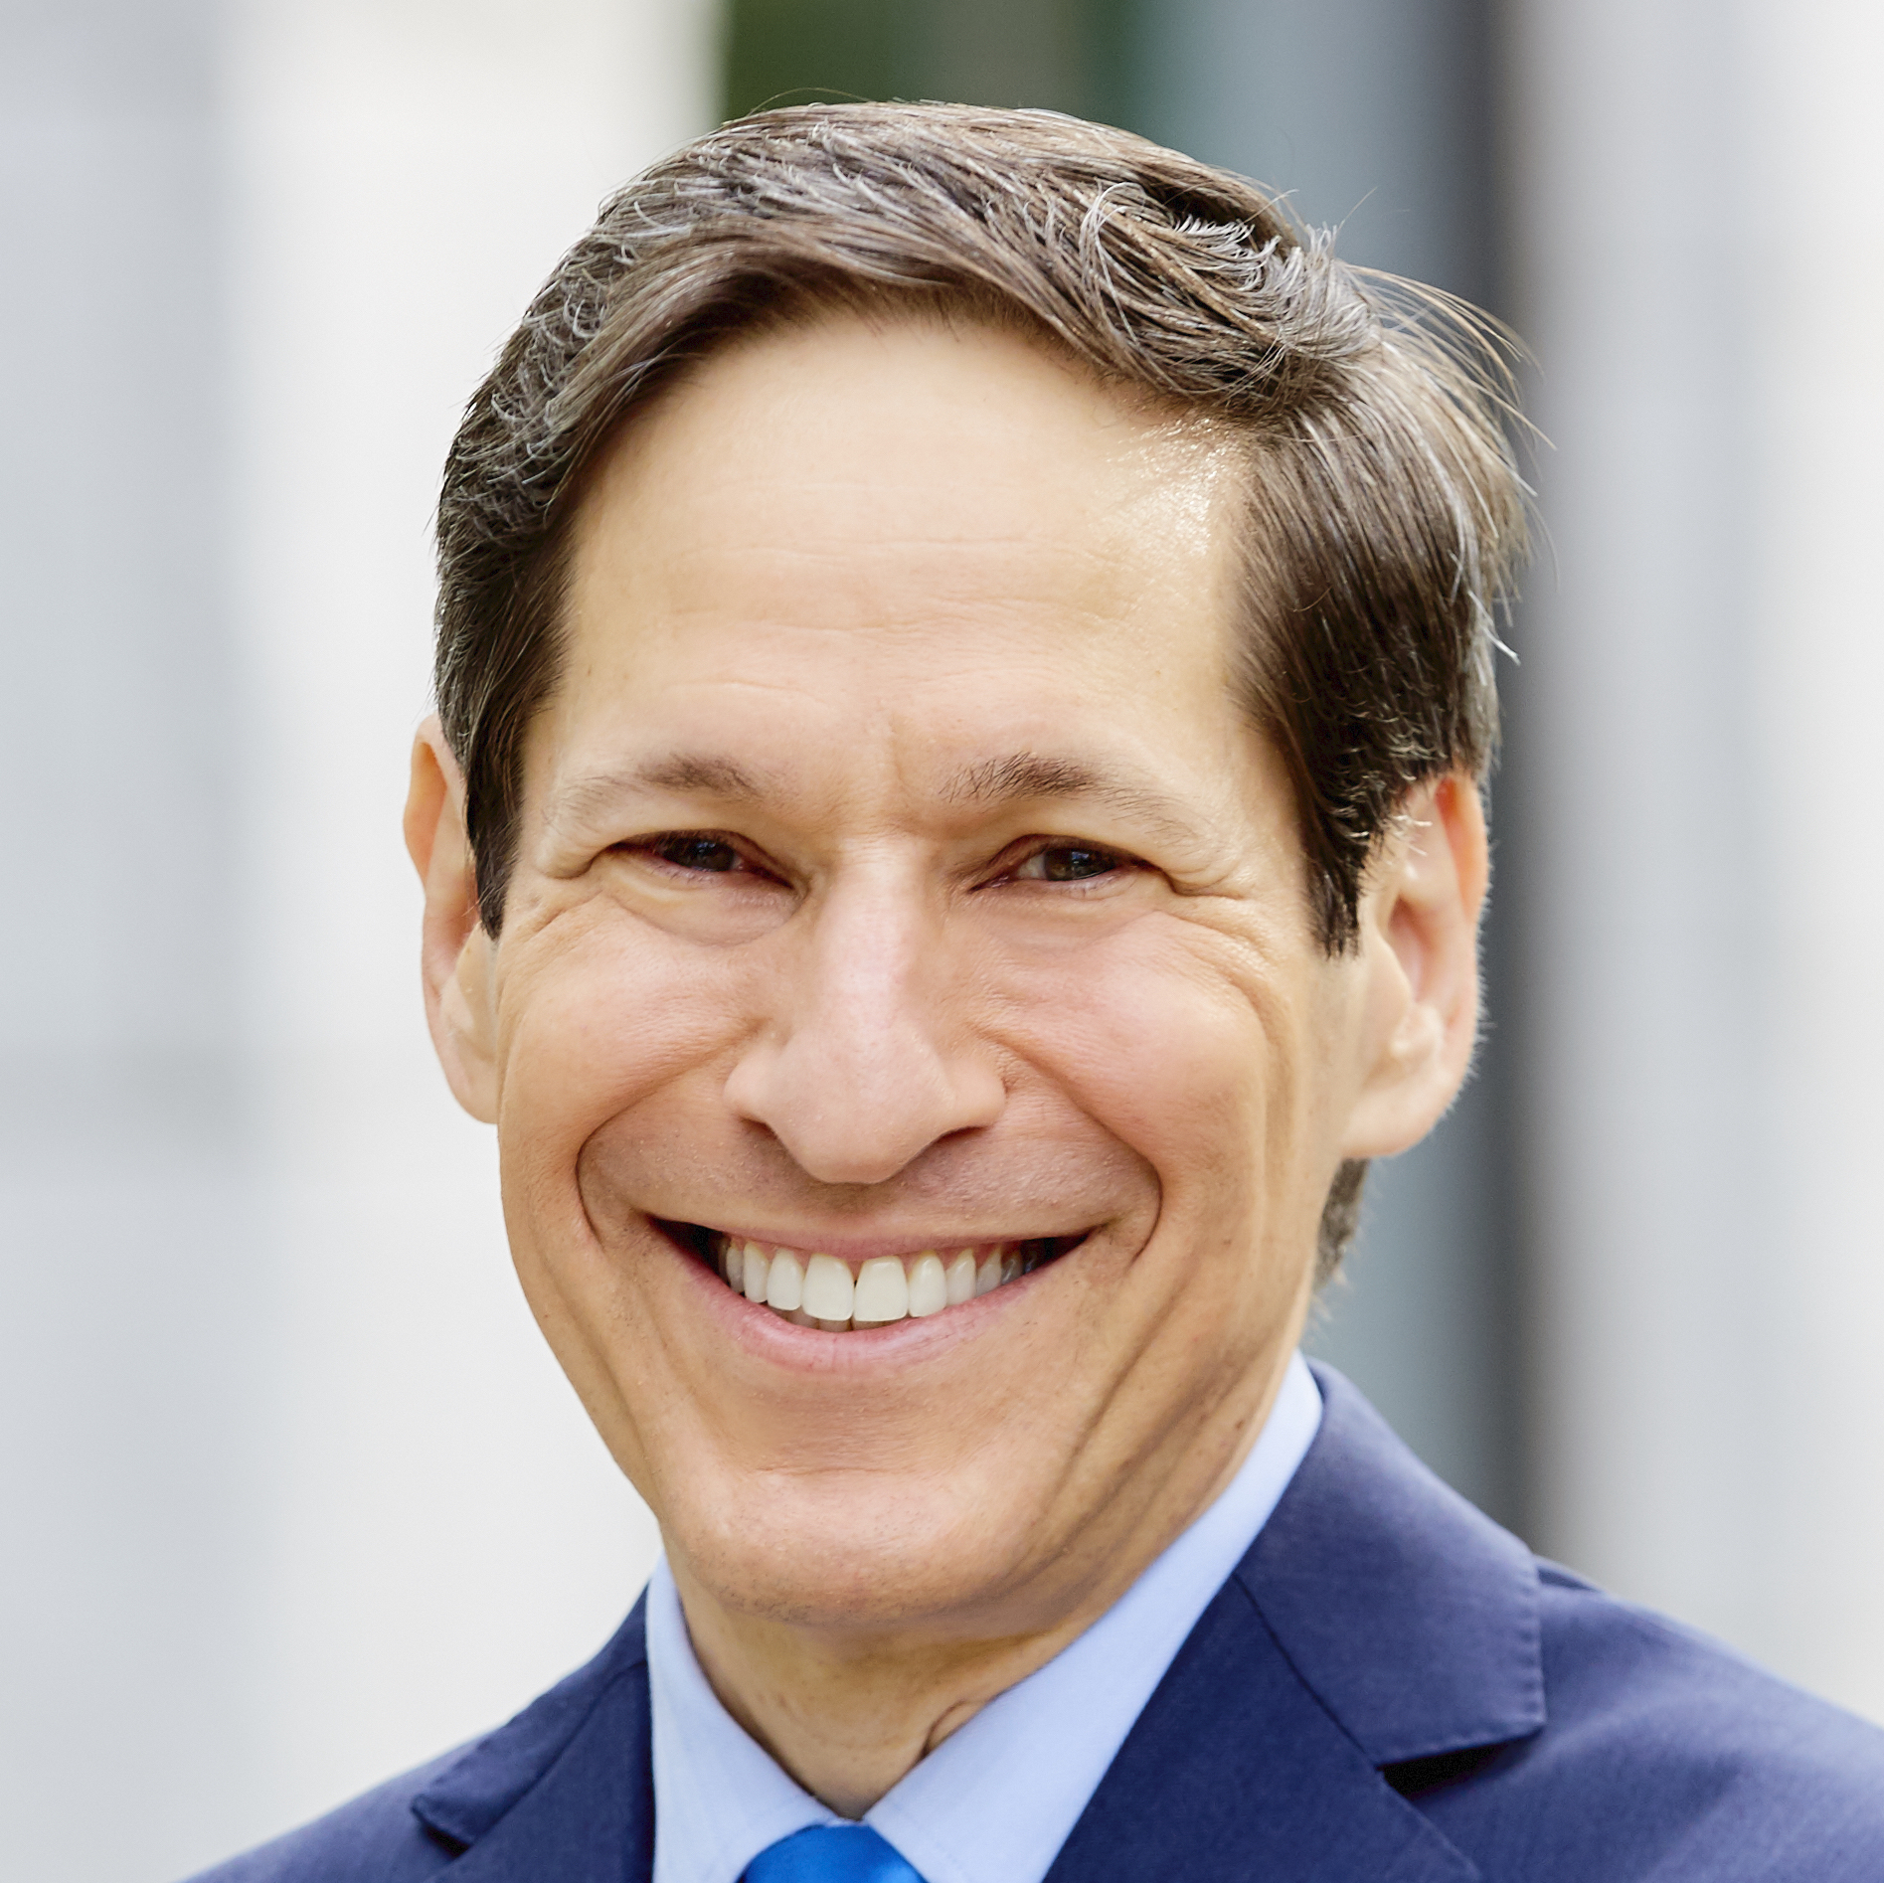
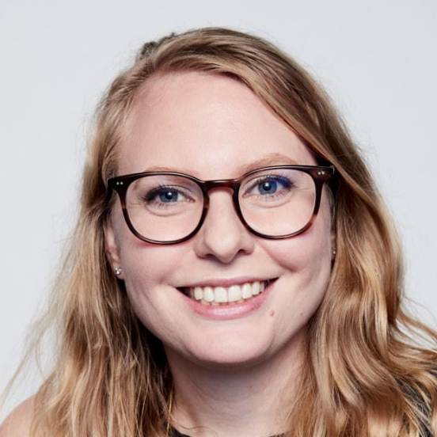
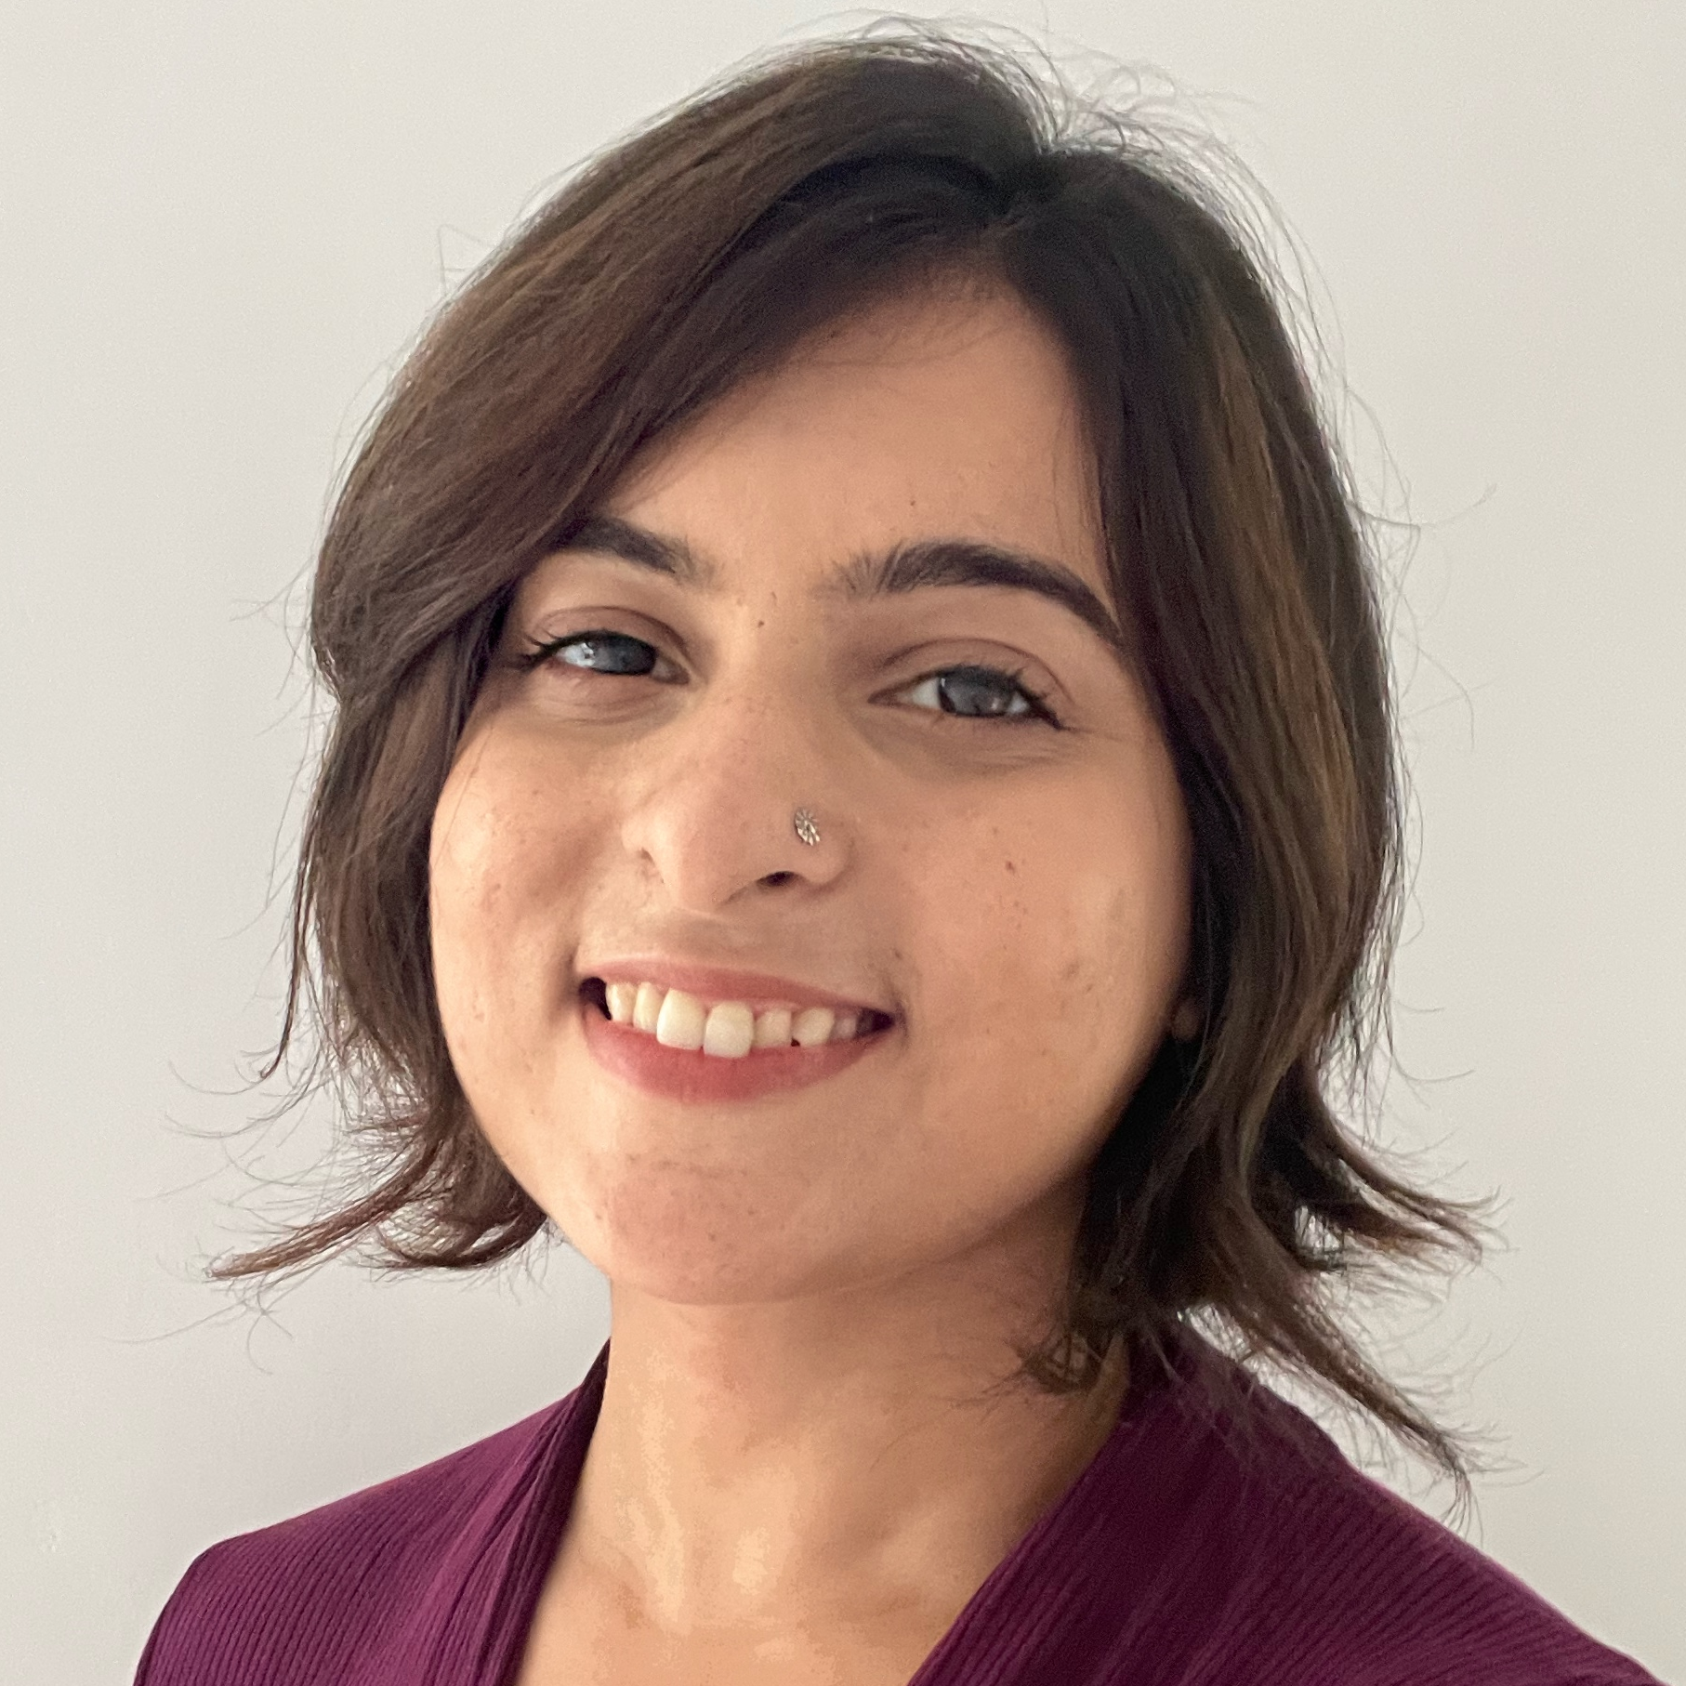
SPEAKERS
Daniel Burka
Resolve to Save Lives, Director of Design, Digital
Alain Labrique
WHO, Department of Digital Health and Innovation, Director
Suhel Bidani
Bill & Melinda Gates Foundation India Office, Lead, Digital
Marelize Gorgens
World Bank,
Digital Lead
Effective digital systems designed for and with health care workers
Dr. Tom Frieden
Resolve to Save Lives, President & CEO
Shelagh McLellan
Google, Design Lead
Aarti Bhatnagar
DHIS2, UX Researcher
May 8, 2024
9am EDT/ 3pm CEST/ 6:30pm IST

